Slide 1

name that fruit!
Hannah Li, Trisha Paul,
Puja Subramaniam, Shelby Watson
Notes:
Shelby
Bring the fruits for people to identify to start the presentation- make it fun!

Slide 2





Agenda
01
Business problem
02
Data Set
03
Dimensionality Reduction
04
models
05
Conclusions & next steps

Slide 3

Business problem
Grocery stores:
Accuracy at checkout
Reduction in waste
Save time and money!
Notes:
I will expand upon this in presenting- provide examples and context, relate to my own experience working in a grocery store

Slide 4



Data set Overview
60,498
Total Images
Test images
Training Images
82,213
21,715
Notes:
82,213 total images : 61,488 training : 20,622 test
images - 100x100 pixels
each fruit has 100-900 images

Slide 5



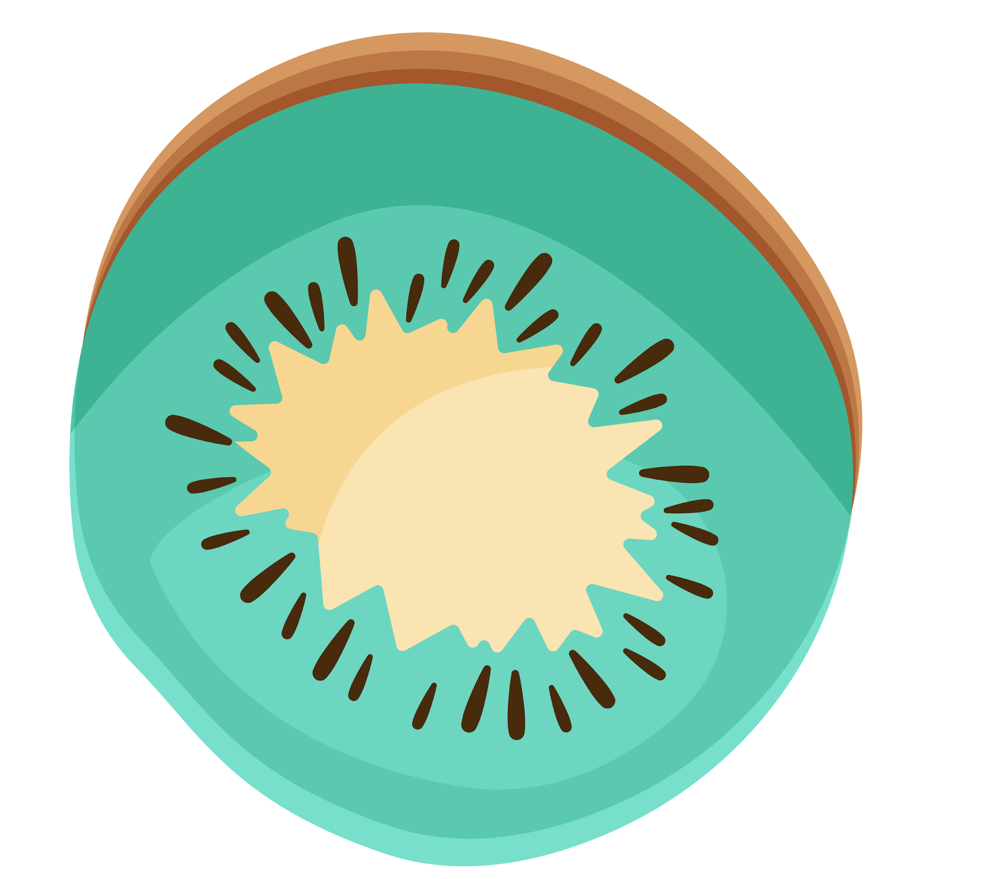
types of fruits
9 types Lemon, Lemon Meyer, Limes , Mandarin, Grapefruit Pink, Grapefruit White, Orange, Clementine, Kumquats
16 types Apricot, Nectarine, Nectarine Flat, Peach, Peach 2, Peach Flat, Plum, Plum 2, Plum 3, Cherry 1, Cherry 2, Cherry Rainier, Cherry Wax Black, Cherry Wax Red, Cherry Wax Yellow, Dates
22 types Banana, Banana Lady Finger, Banana Red, Carambula , Lychee, Cactus fruit, Pineapple, Pineapple Mini, Pitahaya Red, Cocos, Guava, Mango, Mango Red, Papaya, Passion Fruit, Kiwi, Mangostan, Maracuja, Pomegranate, Pomelo Sweetie, Rambutan, Tangelo, Salak
Apples/Pears
Berries
Citruses
15 types Strawberry, Strawberry Wedge, Blueberry, Raspberry, Granadilla, Grape Blue, Grape Pink, Grape White, Grape White 2, Grape White 3, Grape White 4, Huckleberry, Mulberry, Physalis, Physalis with Husk
13 types Apple Braeburn, Apple Crimson Snow, Apple Golden 1, Apple Golden 2, Apple Golden 3, Apply Granny Smith, Apply Pink Lady, Apple Red 1, Apple Red 2, Apple Red 3, Apple Red Delicious, Apple Red Yellow 1, Apple Red Yellow 2
Tropical
Drupe
Notes:
82,213 total images : 61,488 training : 20,622 test
images - 100x100 pixels
each fruit has 100-900 images

Slide 6
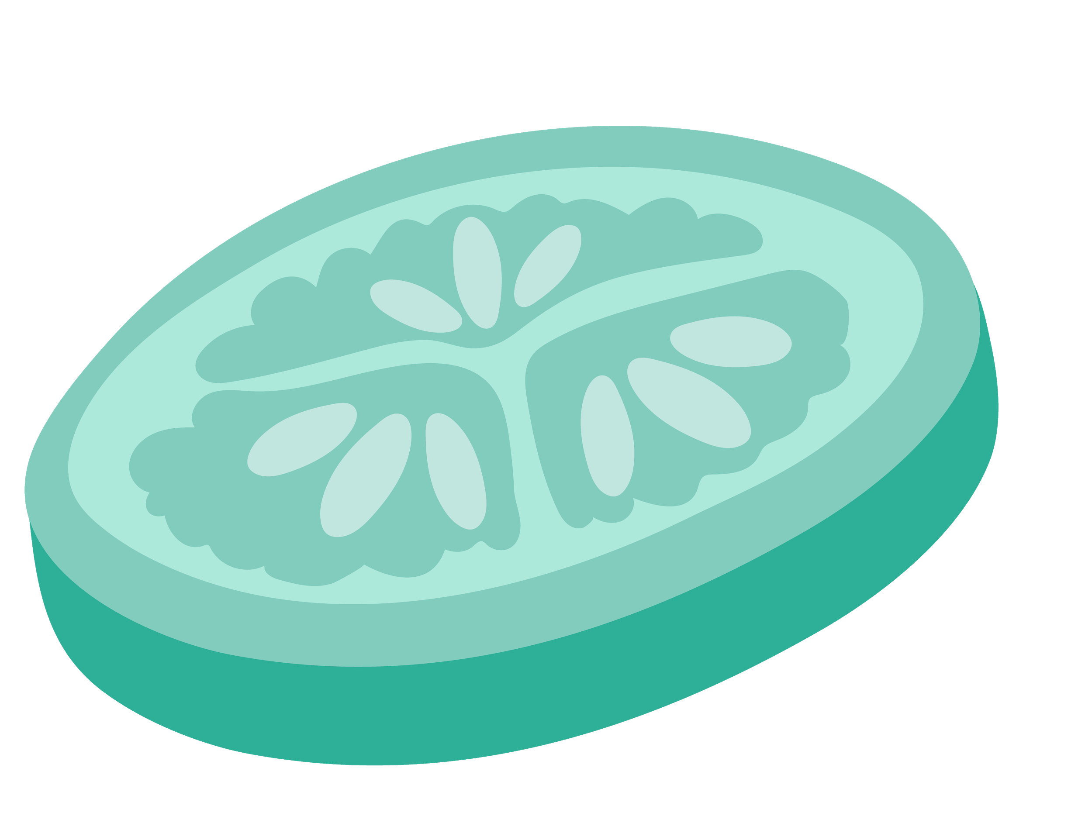


types of fruits
3 types Cantaloupe 1, Cataloupe 2, Melon Piel de Sapo
8 types Tomato 1, Tomato 2, Tomato 3, Tomato 4, Tomato Cherry Red, Tomato Maroon, Tomato Yellow, Tamarillo
Nuts
Vegetables
4 types Avocado, Avocado ripe, Kaki, Redcurrant
Melons
16 types Cauliflower, Beetroot, Onion White, Potato Red, Potato Red Washed, Potato Sweet, Potato White, Eggplant, Pepper Green, Pepper Red, Pepper Yellow, Onion Red, Onion Red Peeled, Kohlrabi, Ginger Root, Pepino
Other
Tomatoes
4 types Chestnut, Hazelnut, Walnut, Nut Forest
Notes:
82,213 total images : 61,488 training : 20,622 test
images - 100x100 pixels
each fruit has 100-900 images

Slide 7
Dimensionality
AGE
100
Each Image:
100 x 100 pixels
3 values each (RGB)
30,000
Features!!!
100
Notes:
82,213 total images : 61,488 training : 20,622 test
images - 100x100 pixels
each fruit has 100-900 images

Slide 8



Dimensionality reduction
PCA and t-SNE
Notes:
Shelby handoff to Hannah
preprocessing
lots of features so we want to see if we can reduce the dimensions to make the dataset more scalable and run faster without reducing variance (so we can maintain integrity of dataset before classifying)

Slide 9

PCA versus t-SNE
PCA
t-SNE
Linear feature extraction
Linear mapping of the data to lower dimensional feature space
Each new feature is independent of each other
Non-linear dimensionality reduction
Can map multidimensional data in 2D space
Notes:
Hannah
we wanted to reduce the dimensions since each picture has 10000 components and we have over 80000 pictures.
we looked into PCA and tsne.
PCA is linear feature extraction
TSNE is non linear

Slide 10
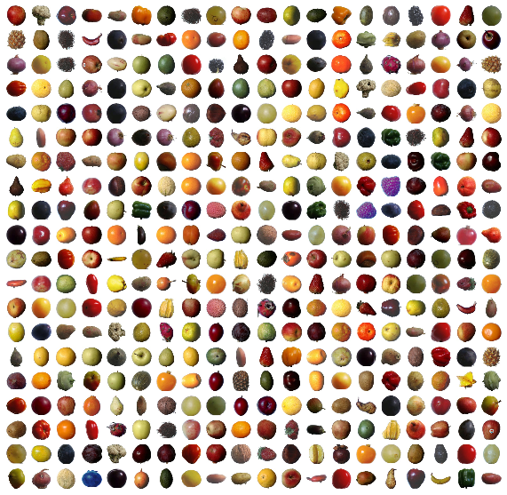
400 Data Points
10000 Components
No Feature Extraction
Notes:
Hannah
Here is a sample of our data (400 data points). No PCA performed here, 100 components in each image, no feature extraction done yet.

Slide 11
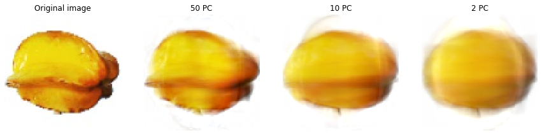
PCA on Star Fruit
Notes:
Hannah
a visual representation of pca on an image. we see that the image becomes smoother/less components

Slide 12
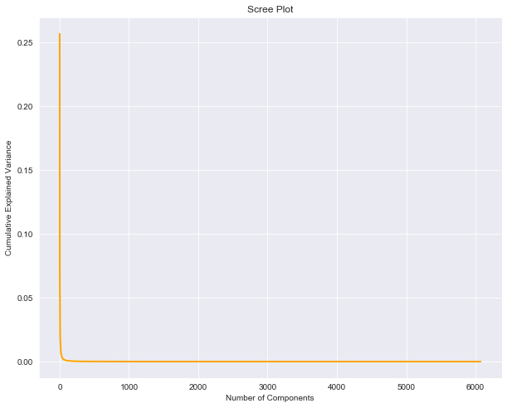
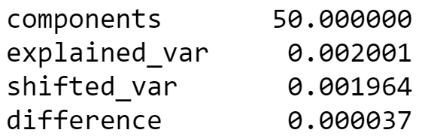
‘Elbow’ of Scree Plot: ~50 components
Notes:
Hannah
we wanted to make sure PCA was a good idea, so we created a scree plot to see if we could significantly reduce the number of dimensions while retaining variance

Slide 13
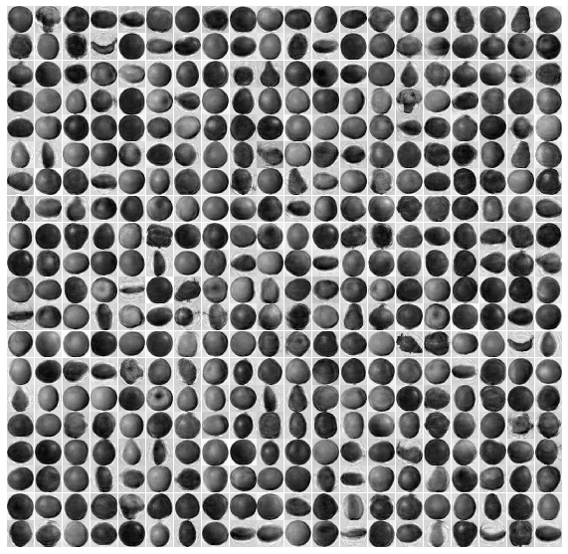
400 Data Points
50 Components
PCA Performed
Notes:
Hannah
We looked at the scree plot to get the optimal number of components (timing/complexity). We used 50 components in our PCA extraction. This is how our sample data now looks.
We wanted to visually see how well our fruits were still grouped together even after feature extraction so we plotted our PCA results on a tsne plot (to visualize multidimensional)
embeds high dimensional data for visualization in low dimensional space

Slide 14
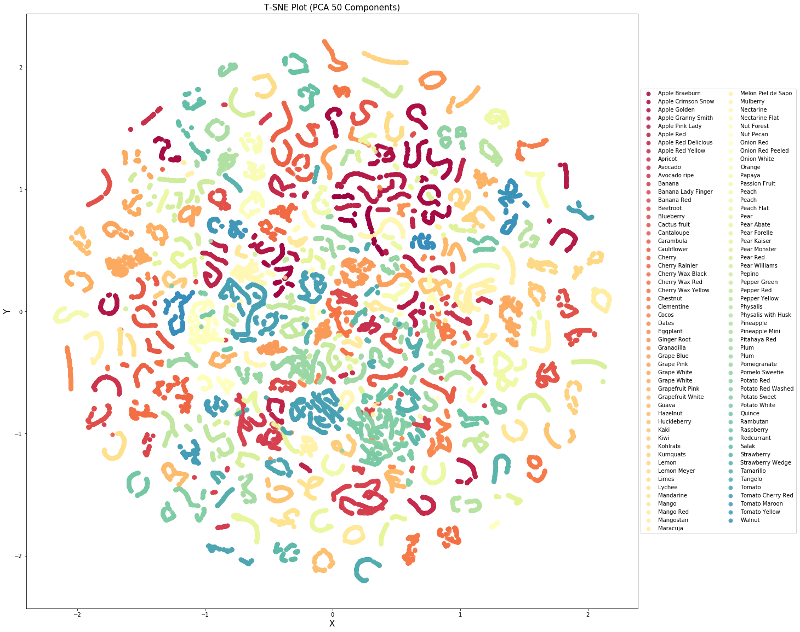
T-SNE can plot 50 components in 2D space
PCA groups fruits together
Notes:
Hannah

Slide 15
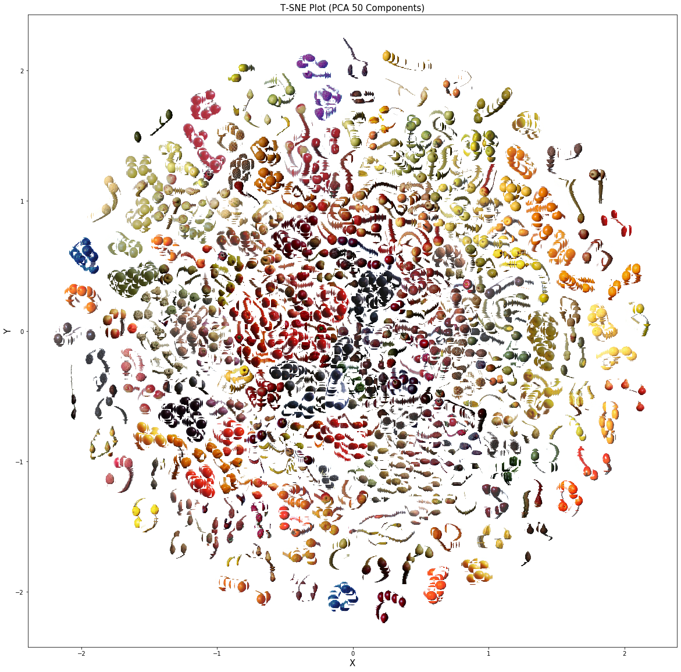
T-SNE image plot of fruits
Better visual of fruit classes
Notes:
Hannah

Slide 16

Models tested
knn
cnn
decision tree/
random forest
Notes:
Hannah handoff to Puja

Slide 17
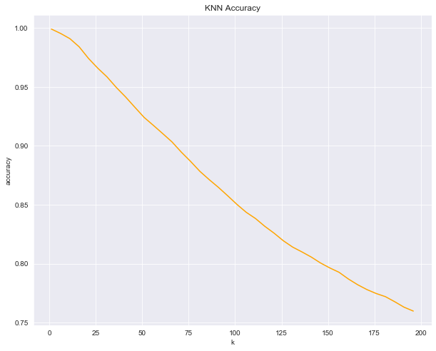
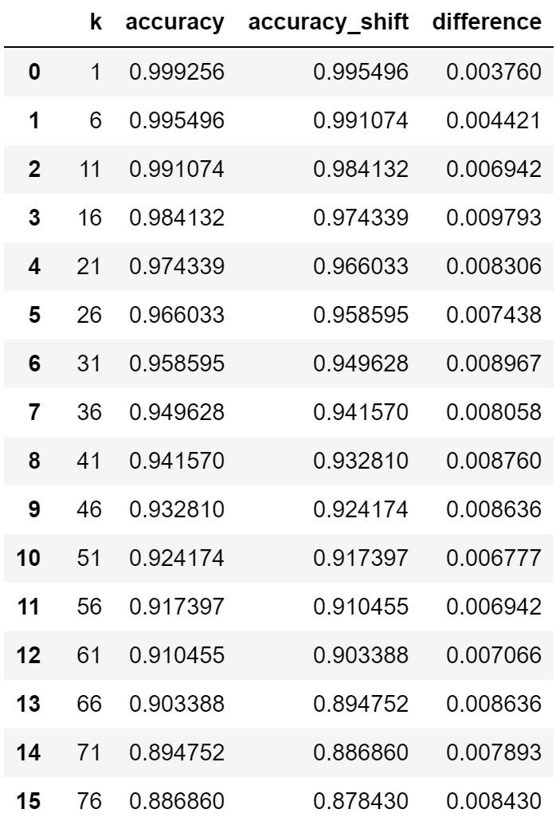
KNN
Validation Accuracy: 99.93%
Test Accuracy:4
94.49%
Optimal k value:
1
Why KNN?
Fruits were clustered using PCA → lent itself to KNN to give higher prediction accuracy due to dimension reduction
Notes:
Puja
Good for low dimension data but we still have 50 dim
Accuracy plot run on the validation set to fine tune our params
Obvious that it decreases with K, but difference between each seemed to slow down
Did not want to overfit so picked k = 11

Slide 18
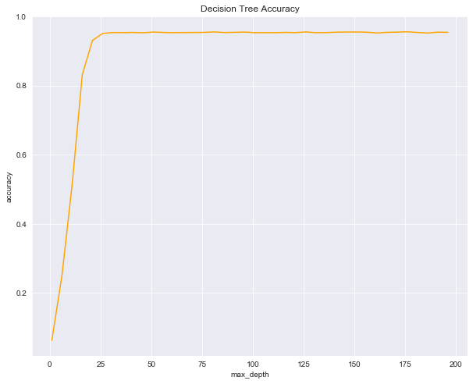
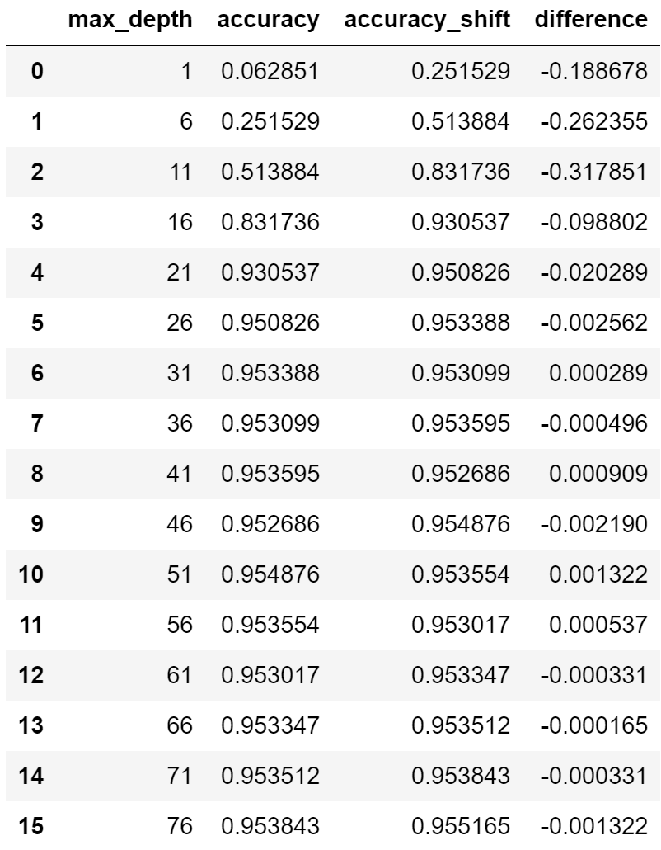
Decision Tree
Validation Accuracy: 95.31%
Test Accuracy:
74.92%
optimal max depth:
36
Why Decision Tree?
Stand alone tree will always have low accuracy → wanted to see if PCA would help the model
Notes:
Tested on max depth to see how many splits total
Accuracy jumped at around 21, and then continued increased accuracy until 31 so picked max depth of 31 (which is still small in comparison to the total number of training data we have)

Slide 19
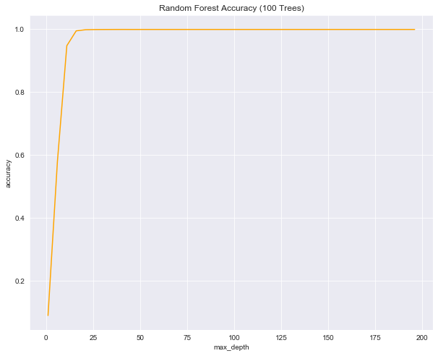
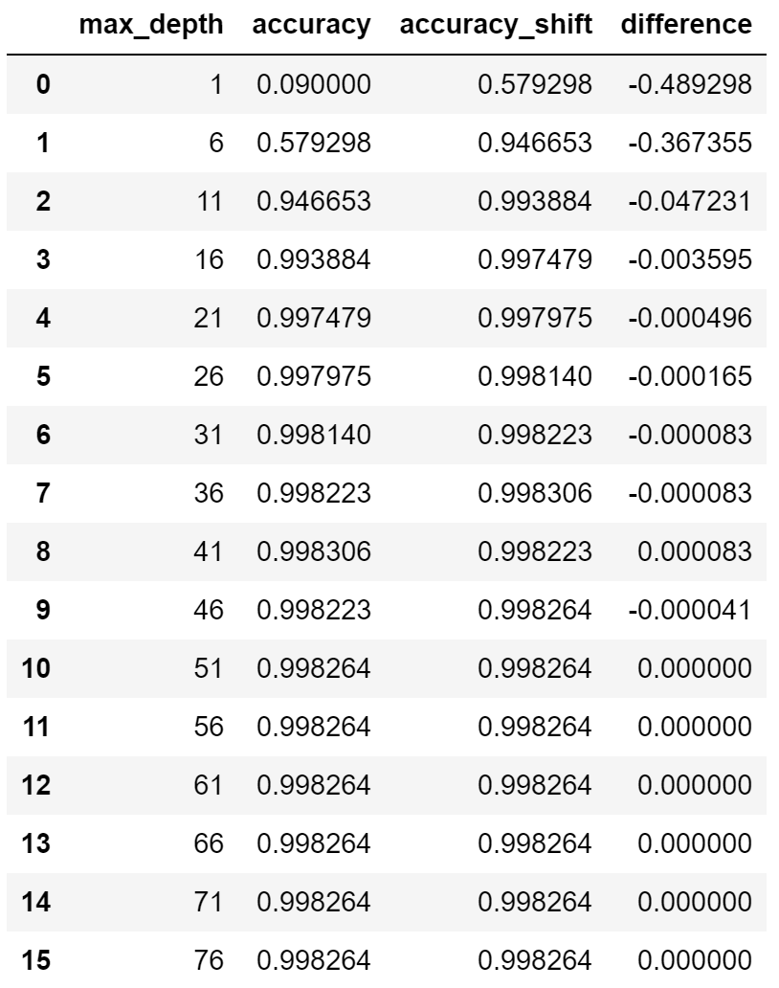
Random Forest
Validation Accuracy: 99.82%
Test Accuracy:
85.09%
optimal max depth:
46
Why RF?
Compensates for errors in each individual trees to develop better learned model
Notes:
Puja
Each model uncorrelated so together, more accurate than single decision tree
Improved test accuracy compared to decision tree
Number of estimators = 100 (built 100 trees)
Max depth lower on this than on decision tree (plateaus)

Slide 20
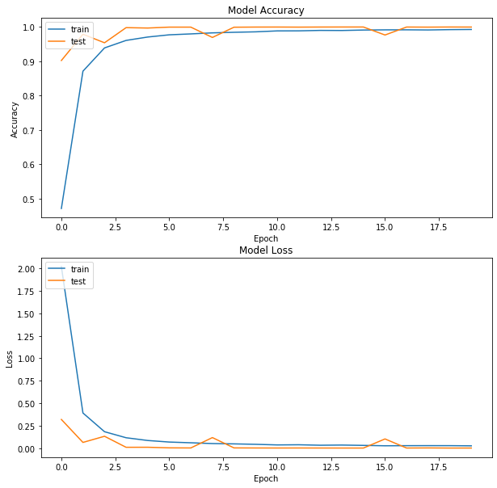
CNN
Validation Accuracy: 99.91%
Test Accuracy: 98.42%
optimal Parameters
Batch Size: 120
Epoch: 20
Activation: ReLU
Why CNN?
Best one shot at properly classifying images
Notes:
Trisha
So coming into the project, we knew that CNN would perform the best because it’s one of the most popular methods of analyzing images. CNN has input, hidden, and outputs layers, The convolutional layer, has filters that detect different patterns when the images go through them. As the images are sent through deeper layers, the feature detection gets more and more sophisticated. In our model we had 4 con layers, with filter sizes doubling per layer and we use ReLU as the activation function, since its known to train the network faster without much loss on accuracy. For our best model, we ran it with 20 epochs and a batch size of 120. This had a validation accuracy of 99.91% and test accuracy of 98.42%.
CNN is the the most popular method of analyzing images, we used 4 convolutional layers with increasing number of filters.
the pattern detection is what makes CNN so useful for image detection and the convolutional layers are what make it distinct from other neural networks and what detects the patterns
diff filters within the con layers are what detect the patterns; the deeper the layers, the more sophisticated the filters get
after specifying the number of filters and filter size, the image is put through first layer where the pixels are convolved by a filter and the feature map is then sent to the next layer. And with each layers, different features are detected. ReLU, however, is a popular choice because it can train the network faster without any major penalty to generalization accuracy.

Slide 21
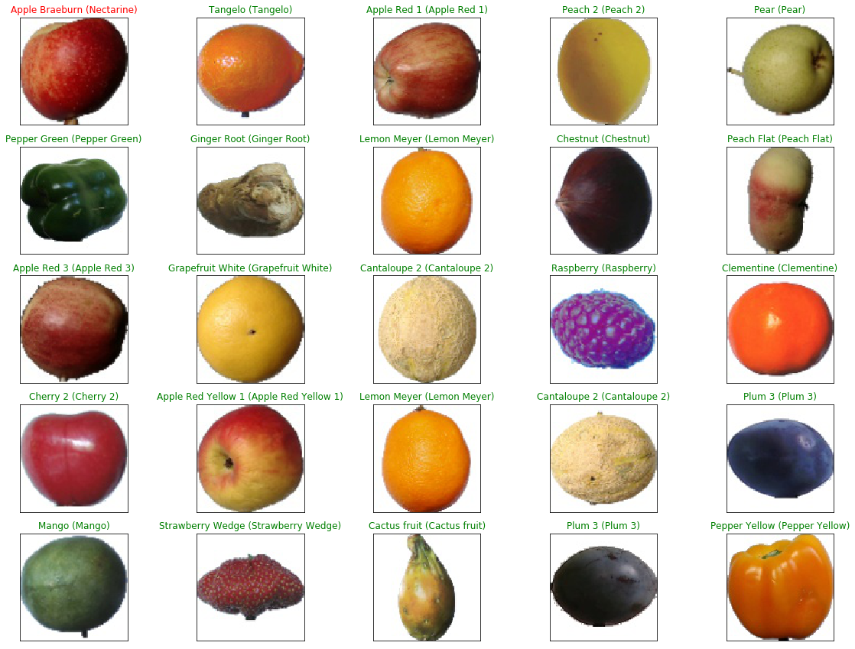
CNN Results
Notes:
Trisha
Here is one of results from the model. We ran multiple times and most of the time it predicted all 25 images perfectly or had 1-2 errors. So in this example, it incorrectly identified the cherry thinking its a hazelnut and red potato as beetroot.

Slide 22
Transfer Learning
VGG16
More parameters than AlexNet
Slow neural net to train
Hidden layers use ReLU
Decision function is more discriminative
chALLENGES FACED
Computing Power
Insufficient RAM
Run time
Notes:
Trisha
Transfer learning includes models that have been trained on many images already so our model would be trained on top of that, so accuracy should be higher.
We decided to further our testing with Transfer Learning, specifically VGG16 and Inception V3. We picked VGG16 because it is known to have better results than AlexNet and its 3 fully connected layers control for overfitting and underfitting. The inception-V3 was also run because it should provide better accuracy and shorter run time.
VGG16: 16 weight layers in the network
Inception: factor 5x5 convolutions to two 3x3 convolutions to improve speed
Label smoothing: regularizing component added to loss formula to prevent network from becoming too confident about class

Slide 23
Conclusions / Next Steps
Noise
detection
OPTIMIZE MODELS
tune model parameters
Data set too large to run locally or on Google Collab → work on better storing on GCP
Utilize Transfer Learning methods to better train models
Use optimized models to detect fruits even with noisy backgrounds
Notes:
Shelby - incremental PCA, different batch sizes, epoch numbers
multiple fruit detection, noisy backgrounds

